Slide 1

The regulators: understanding demands, looking for balance
Mark Thomas
Director,
ECO, Copenhagen

Slide 2




CEPT, ECC, ECO
= Regulatory Authorities and relevant ministries
The part of CEPT that deals with spectrum =
= The permanent office of the CEPT
(95% → ECC )

Slide 3
Demands, sharing and balance
The nature of allocation and the reality of spectrum sharing
Who makes the decisions – who takes responsibility for what?
How do regulators come to understand spectrum requirements. How do we deal with them?
Reality and practicality – some case studies

Slide 4
Allocation of frequencies
– what’s that about?

Slide 5
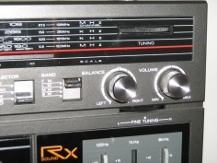


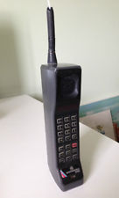
How some people see allocation
Big red fire engines
Old phones

Slide 6


Sharing is the (new?) reality
”don’t be alarmed, you can’t detect us.....

Slide 7

Licensed ? yes,
Exclusive ? not absolutely
Bands may have different primary uses in adjacent countries
Secondary services usually interleaved with a primary service
Adjacent channel interactions are important:
between the same services (e.g. T-DAB to T-DAB)
between different services (e.g. public mobile to GSM-R)
I thought we were exclusive?

Slide 8
Different levels of responsibility
Global – ITU Radio Regulations - Allocations
ITU-R Recommendations = basis of some assumptions and calculations
Radio regulations only deal with management between countries, not within countries
‘European’ – ETSI – CEPT/ECC – European Union
harmonised equipment/system standards;
more detailed spectrum plans; not binding; also ‘soft harmonisation’
working assumptions about allocations and sharing criteria; recommendations/reports
EU – binding harmonising regulations on some sectors
National frequency regulator (NRA)
the point where regulation is applied for everything
(possibly – sector-specific regulator). Depends on national structure:
e.g. broadcasting or public telecommunications
Licensees – operators.
implement services according to their specific or general authorisations
Users
unlikely to know or care about who-does-what

Slide 9
Different levels of responsibility
geographic
Global – ITU Radio Regulations - Allocations
ITU-R Recommendations = basis of some assumptions and calculations
Radio regulations only deal with management between countries, not within countries
‘European’ – ETSI – CEPT/ECC – European Union
harmonised equipment/system standards;
more detailed spectrum plans; not binding; also ‘soft harmonisation’
working assumptions about allocations and sharing criteria; recommendations/reports
EU – binding harmonising regulations on some sectors
National frequency regulator (NRA)
the point where regulation is applied for everything
(possibly – sector-specific regulator). Depends on national structure:
e.g. broadcasting or public telecommunications
Licensees – operators.
implement services according to their specific or general authorisations
Users
unlikely to know or care about who-does-what

Slide 10
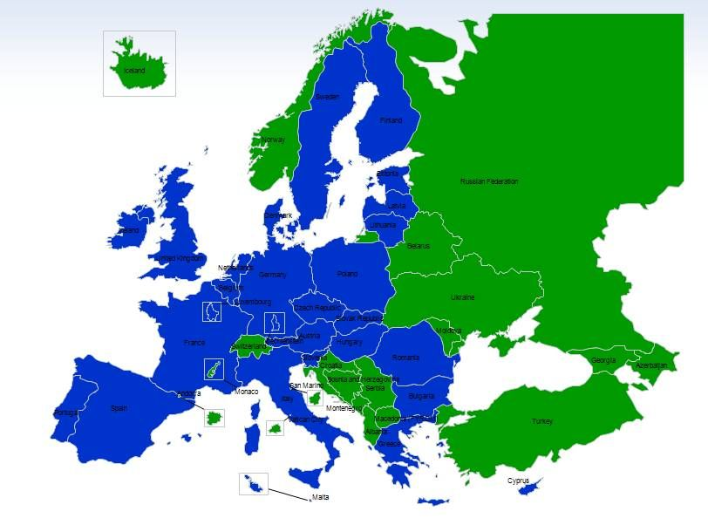
Three main players in spectrum regulation in Europe
ECC:
Spectrum allocation and technical conditions for its use
48 member countries acting together
Technical expertise used by EC
European Commission:
Single market issues
Binding regulations through ‘comitology’ procedures with MS
ETSI:
Equipment and system specifications: including ‘spectrum use’ characteristics
Recognised standards body for ‘harmonised standards’
Makes ‘System Reference Documents’ which inform and trigger much of the ECC work
Largely industry-driven; ‘bottom up’

Slide 11
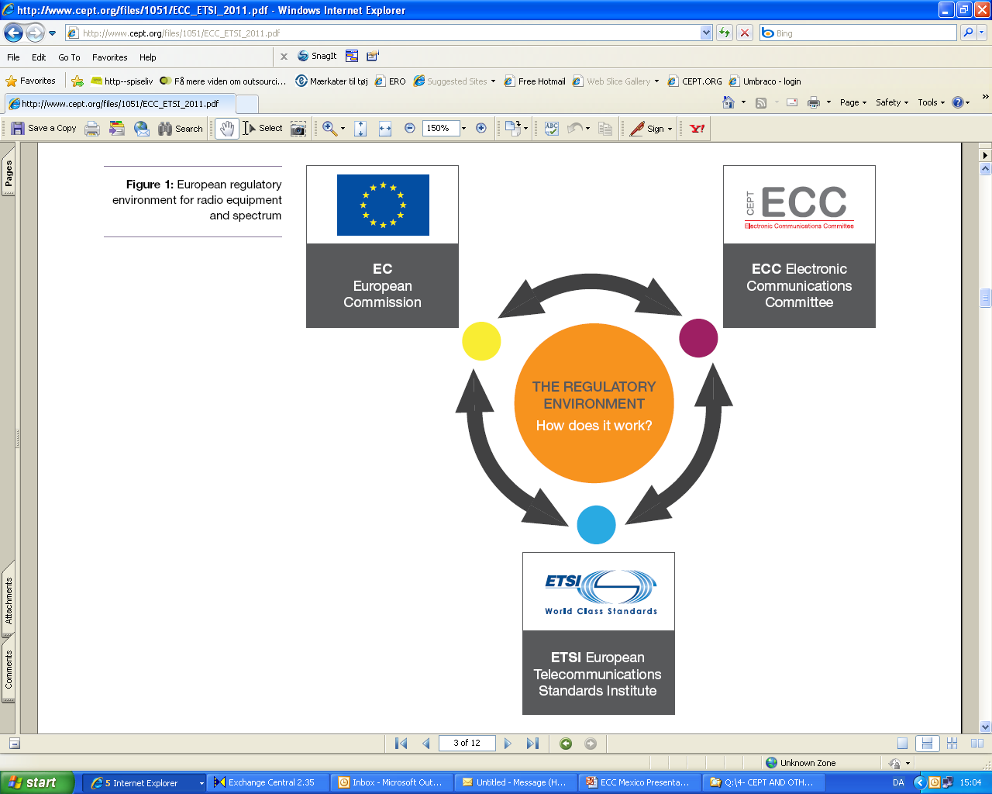


European Frequency Management Framework
2002 Radio Spectrum Decision
RSComm
RSPG
‘EU Telecomms package’:
Commission
Parliament
Council
Radio Spectrum
Policy Programme
(RSPP)
Read more at
http://apps.cept.org/
eccetsirel/

Slide 12
Role of the ECC in Europe
Consensus and voluntary character:
flexible instrument of the national administrations
  Technical expertise (2002 Radio Spectrum Decision)
  EU mechanisms recognise that most regulatory responsibilities are applied at a national level
    (European Commission focuses on single market issues)
  Range of subjects: ‘high profile’ and ‘low profile’:
…all are important
  Geographical reach
  Information focal point

Slide 13
What the ECC does not do
Dictate modes and rules of deployment at the national level
Sell equipment and design installations, plan networks
Regulate inside cables
The impossible:
  100% interference-free spectrum use
  Make every stakeholder 100% happy 100% of the time

Slide 14
How demand is recognised by the regulators
National
National frequency strategy processes, broad-basis and usually consulted
Reference to international developments: especially from ETSI and ECC
Lobbying by companies, trade associations, even individuals
European
ETSI System Refeence document. Mainly industry-led. Administration input is rare.
ECC work items: need 6 supporting administrations to get started
EC mandates – usually reacting to developments in ECC
Global
ITU: World Radio Conference (WRC) agenda items; ITU-R study programme
Worldwide sector-specific industry groups. e.g. DVB, 3GPP

Slide 15
National administrations - influences
Independent regulators have terms of reference set out in law
Criteria for decision making do not anticipate specific merits of a given case – regulator has to apply them
EU Framework Directive requires transparency
(Article 6 requires consultation)
Governments have means to influence regulators; details vary
National reference strategy document
Inputs from sector associations and large companies
Studies: technical and economic
Feedback from licensing and compliance responsibilities
The green ink brigade?

Slide 16
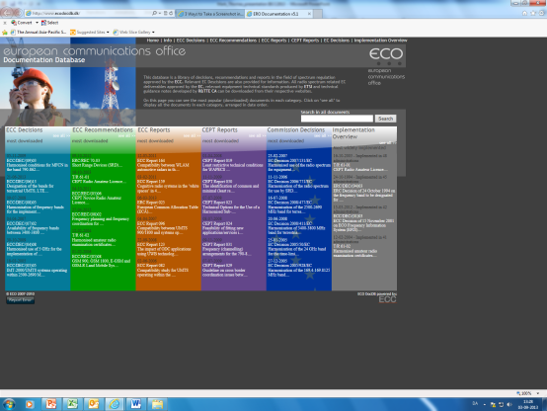
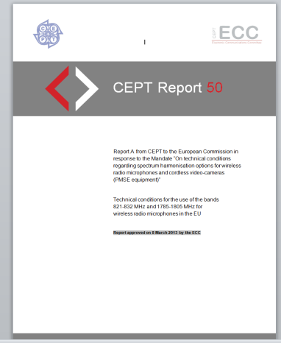
ECC Deliverables
Not about choosing
”stop doing this, do that instead”
Is about opportunities and sharing:
How to protect incumbents adequately if individual countries want to
Maximise efficiency, not ‘protect 100%’
Consider impact of interference
Analyse based on assumed deployment scenarios
Tend to avoid economic or social judgements
Tear down protection of unused harmonisation
measures (e.g. S-DAB in L-Band)
Liberalise existing allocations, e.g.
  free circulation and use of terminals
  least restrictive technical conditions
  technological neutrality
Soft harmonisation can be more flexible and effective than diktat

Slide 17
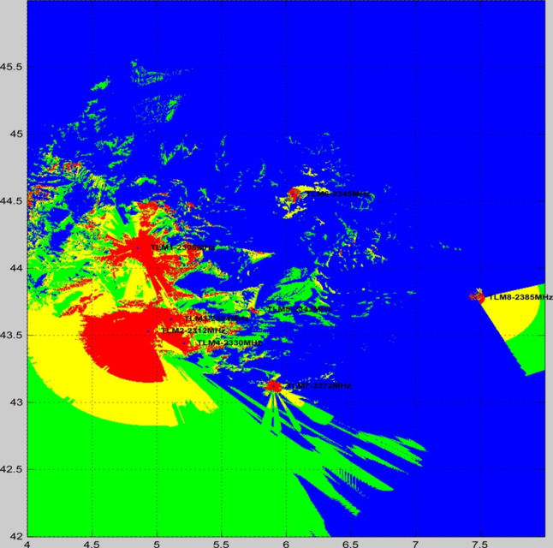
Modern art?
No, it is from a sharing study on how to introduce mobile service in a band used differently in different countries by a variety of services (2.3-2.4 GHz)
The application of the LSA (Licensed Shared Access) concept is central to the acceptibility of bringing mobile servcies into this band.
PT FM52

Slide 18
Reality and practicality
– some case studies
Public mobile networks and GSM-R
800 MHz: Digital Dividend and TV
PMSE, running from the relentless march of LTE ?

Slide 19
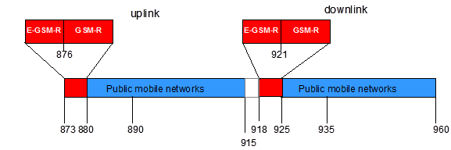
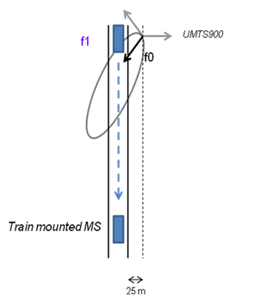
Trouble on the tracks
Digital dividend uplink
Public mobile networks
Independent networks,
Site planning not coordinated...
862
High public mobile local field strengths
(e.g.) Intermodulation products in the railway passband

Slide 20
Trouble on the tracks
- ECC responses
ECC Report 162 looked at various interactions and advised policy mitigations (giving pros and cons):
e.g. coordination between operators about base station siting, isolation corridors, coordination distance, more GSM-R base stations, improving GSM-R receiver performance, external filtering
WG FM correspondence Group on GSM-R: (proposed by UIC)
Questionnaire about field cases to date – valuable information, both context and detail
Field measurements: evaluate impact of:
  cab radio quality
  different public mobile technologies

Slide 21
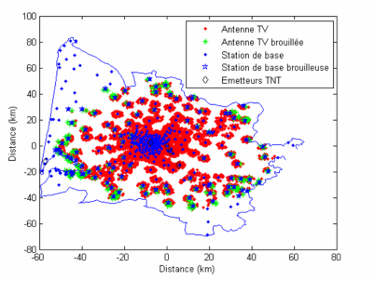
800 MHz ‘Digital Dividend’
At the European Level
ECC developed technical conditions to enable a binding allocation decision within the EU, and a technical framework for non-EU CEPT countries.
At the national level:
Licensing and planning measures to understand
and limit inteference effects
e.g. ANFR report on mobile broadband interfering
into TV channel 60 in France
Harmonised conditions for MFCN in the band 790-862 MHz (ECC Decision)
Frequency planning and frequency coordination for terrestrial systems for Mobile Fixed Communications Networks in the frequency band 790-862 MHz (ECC Recommendation)
Rearrangement activities for broadcasting services in 790 - 862 MHz (ECC Report)
DVB-T performance in the presence of UMTS (ECC Report)
CEPT Reports:
Frequency (channeling) arrangements for the 790-862 MHz band”
(Task 2 of the 2nd Mandate to CEPT on the digital dividend)
The identification of common and minimal (least restrictive) technical conditions for 790 - 862 MHz for the digital dividend in the European Union
Guideline on cross border coordination issues between mobile services in one country and broadcasting services in another country
Continuation of PMSE operating in the UHF, including the assessment of the advantage of an EU approach
Technical Roadmap proposing relevant technical options and scenarios to optimise the Digital Dividend
Feasibility of fitting new applications/services into "white spaces" of the digital dividend
Technical Options for the Use of a Harmonised Sub-Band in the Band 470 - 862 MHz for Fixed/Mobile Application (including Uplinks)
Technical Feasibility of Harmonising a Sub-band of Bands IV and V for Fixed/Mobile Applications (including uplinks)
Compatibility between “cellular / low power transmitter” networks and “larger coverage / high power / tower” networks
Least restrictive technical conditions for WAPECS frequency bands
....that is a lot of work

Slide 22

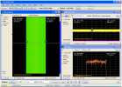
800 MHz ‘Digital Dividend’
Adjacent channel interference
- at the European level
Nov 2009: CEPT Report 30: defines BEM
Nov 2009: CEPT Report 31 defines band plan
May 2010: EC Decision on 800 MHz:
June 2010: ECC Report 148 LTE DTV
Measurements of DTV receiver performance in presence of interference
It is what it says, it says what it isn’t
Feb 2012: RSPP makes licensing of 800 MHz compulsory for MS by Jan 2013

Slide 23
‘Digital Dividend’ – more of the same?
800 MHz band
< 470
> 862
470-790 |  |  |  |  | 790 - 862
TV Ch 21 – 48
SRDs : alarms
etc
48-60
U/L
D/L
APT 700 MHz plan..
And the
TG6 – long term vision
PT 1 – 700 MHz mandate
694 MHz
WRC12’s quasi-arbitrary provisional break point for TV – mobile divide

Slide 24




PMSE – how some see it
We are the wideband boys, We’ll chase you out of everywhere....
800, 700, all TV, 1.5, 2.3, 900, 1.8.... All spectrum will be ours !!!
Photo: The Guardian
Photo: theverge.com

Slide 25
PMSE studies
CEPT Report 50 and addendum on usability of 821-832 and 1785-1805 MHz
(mobile band centre gaps); (SE24; SE7)
Technical conditions to ensure sustainable use of cordless video cameras (FM 51)
Review ECC Report 002 ‘SAP/SAB spectrum use and future requirements’ : new report 204,
and update ERC Rec. on bands and tuning ranges (FM 51)
Reviewing possibiliy of using 2 GHz ‘unpaired bands’ for PMSE (WG FM CR)
Band 1492-1518 MHz reviewed for possible PMSE use (SRD MG)
And more generally: addressing general assumptions on wideband digital systems as interferers: could our existing assumptions be improved? (SE 21)

Slide 26


Users don’t know our assumptions
.......10 m separation for PMSE........
Photo: Line Anhoff, Pressfoto
Is your mobile in your pocket, Emmeline ?
Photo: kristelig dagblad

